Slide 1
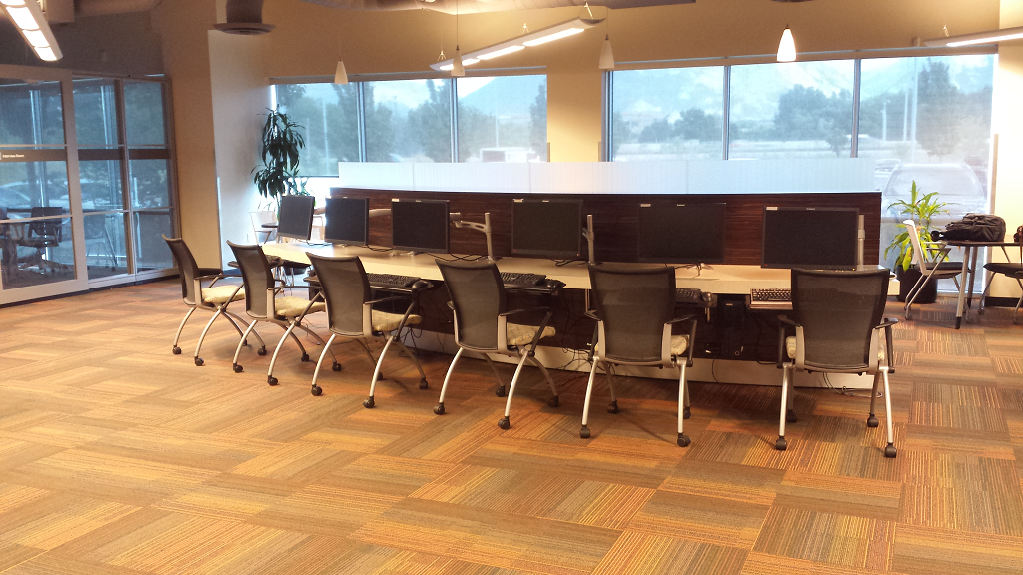
Data Architecture project- part I Elbio iseas dbm/384
Faculty : Devin Dickens
08/22/2016

Slide 2
Introduction
This assignment is about the migration of the
Systems of a company through CSV files and
Uploaded to a temporal database that it will
Be migrated to a Data Warehouse which will
Interact with the Online Transaction Process
(OLTP).

Slide 3
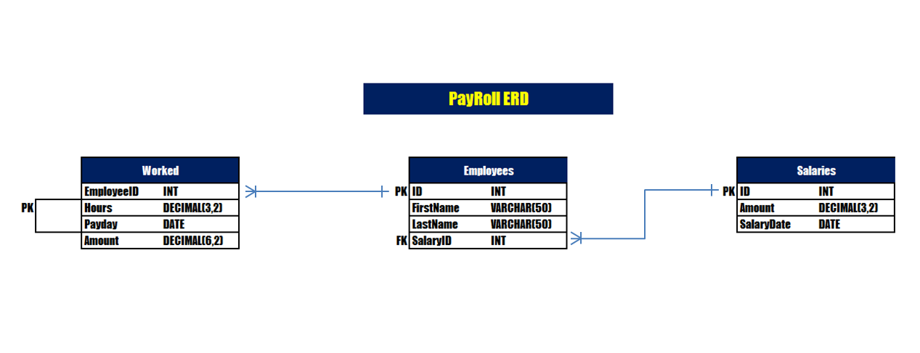
ERD for OLTP

Slide 4
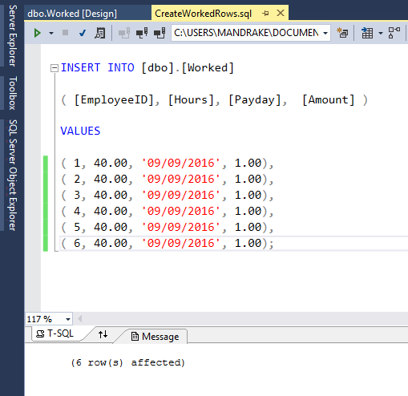
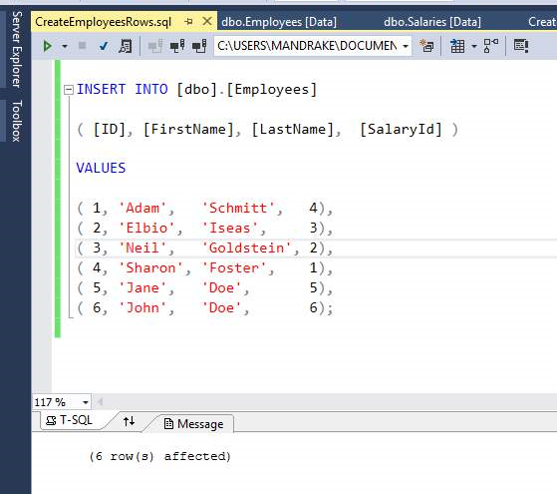
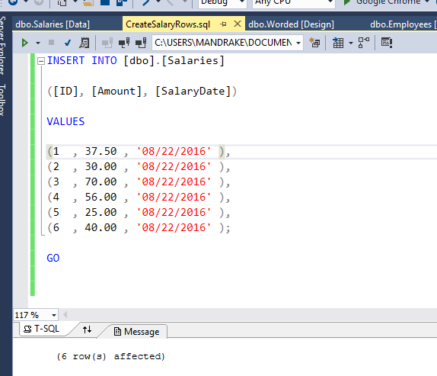
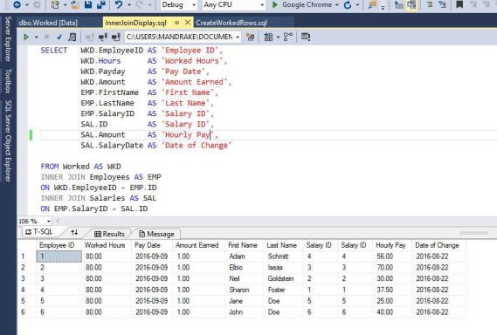
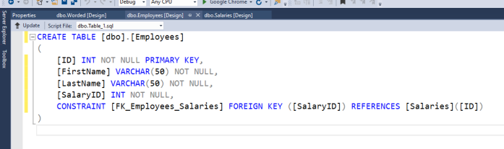
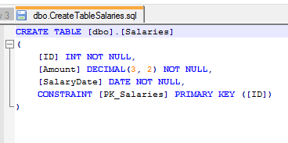
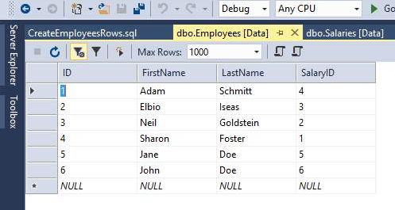
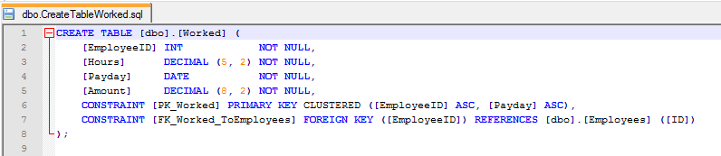
SQL scripts in Microsoft SQL Server

Slide 5
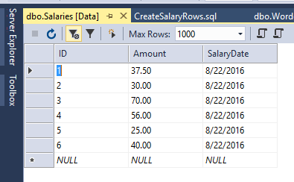
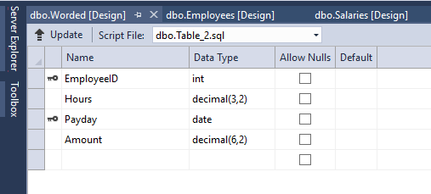
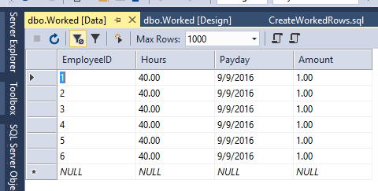
Test scripts and results

Slide 6
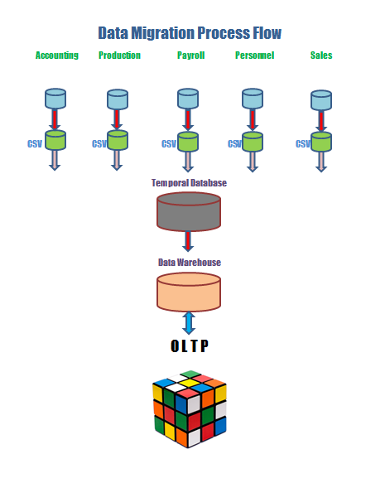
Data Migration Process Flow

Slide 7
Conclusion
This presentation shows only part of the systems involved in the Data Warehouse for the OLTP. All the systems participate in the OLTP but only Payroll is shown here. The idea of this OLTP is to have Create Retrieve Update Delete (CRUD) operations to make faster the system. These transactions are performed with SQL Server 2014.

